Slide 1
DEEP LEARNING IMPLEMENTATION OF FITNESS TRAINER
Junaid Iqbal Khan
Habeel Ahmed
Wajahat Hussain

Slide 2
FYP report reviewed by the Advisor (Yes)
FYP Report uploaded on PMS/ LMS (Yes)
FYP Demo reviewed by the advisor (Yes)
FYP Demo uploaded on PMS/LMS (Yes)
Course feedback of all courses submitted on CMS (Yes)

Slide 3
Outline
Conclusion
Structure of project
Introduction
Objective
Working of the structure
Extension of project

Slide 4
Introduction
Fundamentally
Physical Training
Continuous Monitoring
Prediction
Improvement

Slide 5
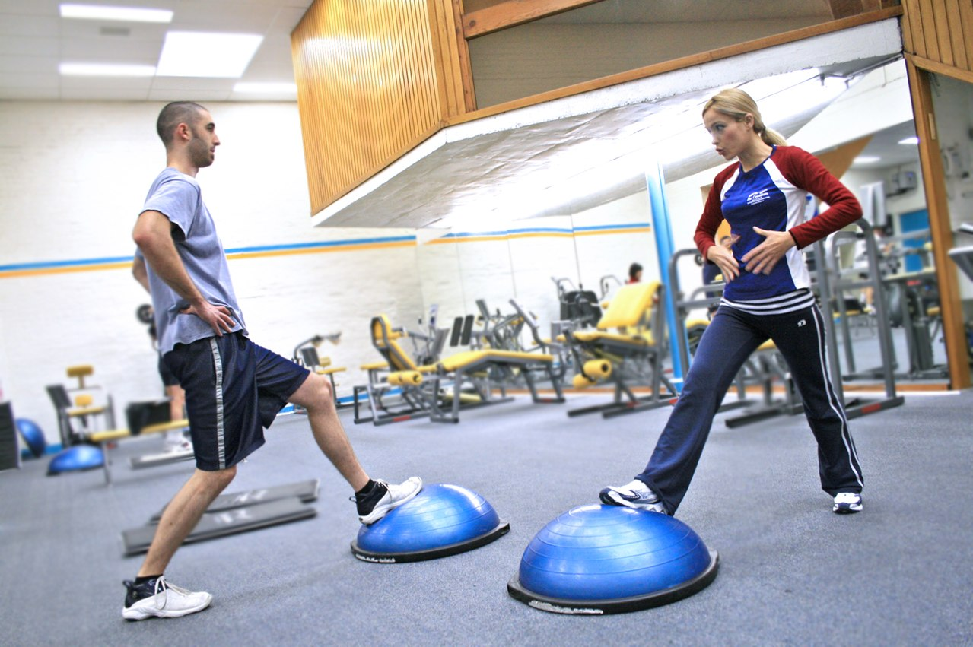
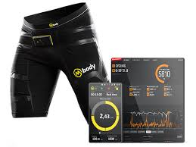
Technology Advancement
Human Fitness Trainer
Automatic Fitness Trainer
More depth
More accurate Results

Slide 6

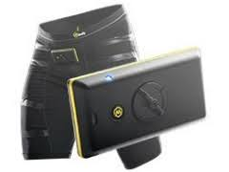
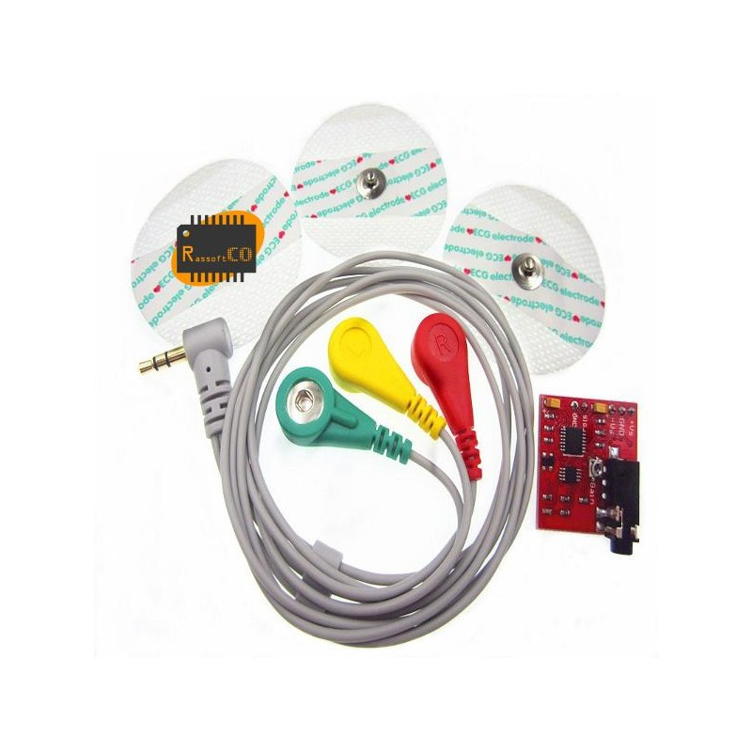
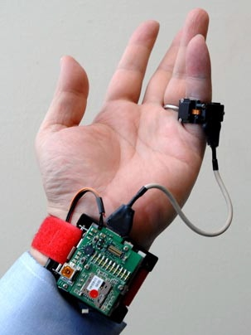
Problems with Existing Automatic Trainers
Inefficient Energy Consumption
Large Volume Occupied
Too Many and Expensive Sensors Used

Slide 7
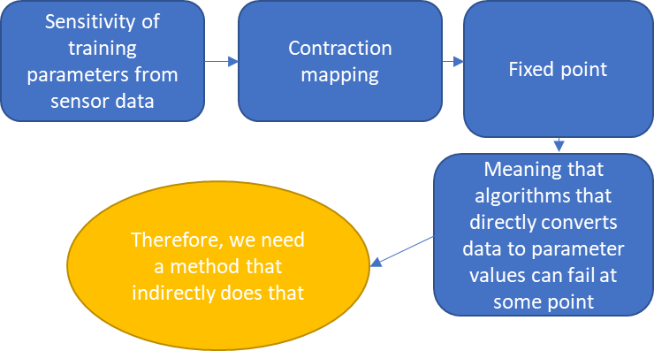
Observations
Average human can burn 180 to 532 calories per hour and thus can produce 0.3 to 0.6W power
Research studies based on expensive sensors can be mapped towards a single cheap sensor data and vice versa, through sequence to sequence to regression

Slide 8
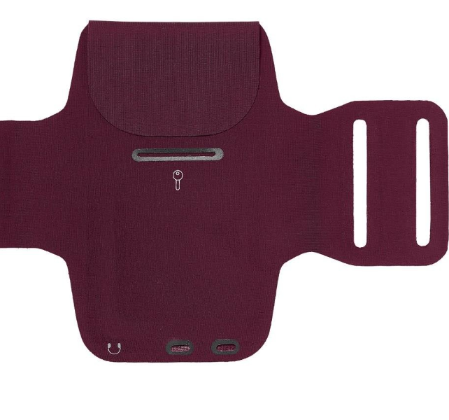
Solution

Slide 9
Cost
Accelerometer
sensor
Accuracy
Calories wasted converted back to energy
Size
Desired Features
Mood evaluation
Workout monitoring through supervised learning
Energy efficient
Workout strategy evaluation based on time series forecasting
Flexibility
User Diversity
Portable

Slide 10
Objective
Accuracy
Accelerometer
sensor
Use Machine learning to design a bicep fitness trainer
Scope of project
Mood evaluation
Workout monitoring through supervised learning
Flexibility
Workout strategy evaluation based on time series forecasting
User Diversity

Slide 11
Structure of Project
Devised Strategy
Time series forecast
Evaluation of training strategy
Pace
Active Reps
Embedded system
Function Regression
Mapping between performance and mood states
RPE
Novice-Pro
Rapidity
sensor
Fatigue
Supervised Classifier
Current Status
Performance

Slide 12
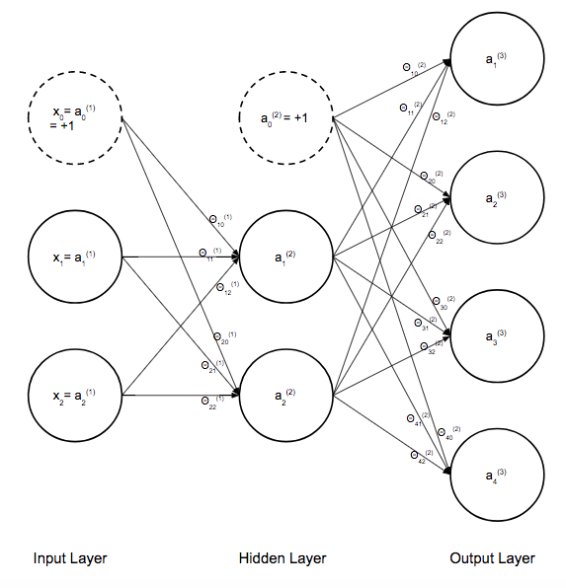
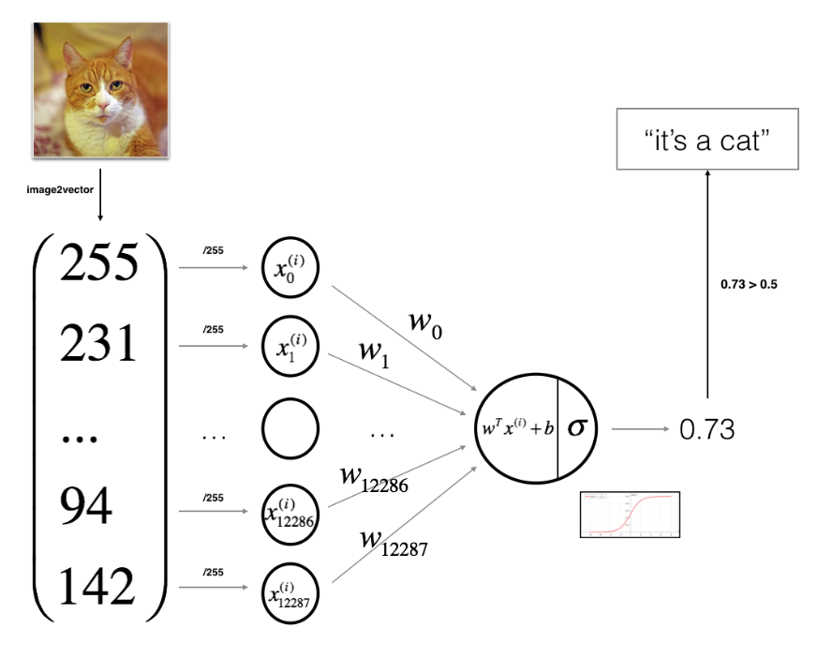
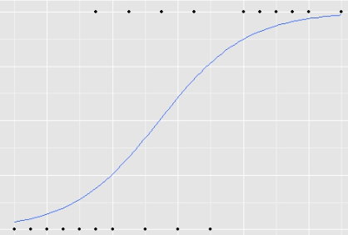

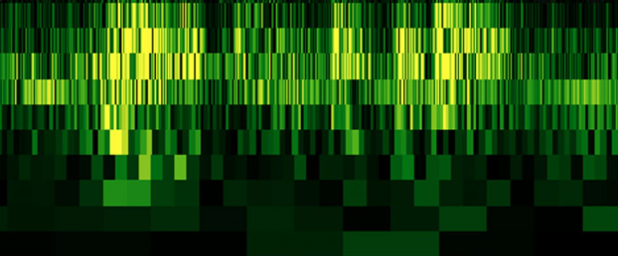
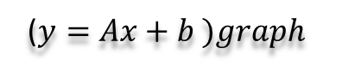
Convolution Neural Network
Supervised Classifier
($y=Ax+b )graph$
Image
Binary Logistic Regression
Convolution Neural Network
Dimensionality Increment

Slide 13
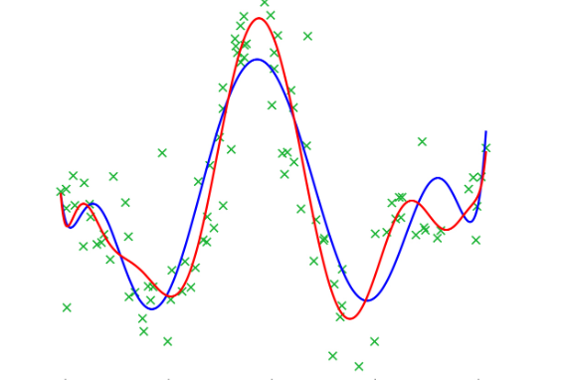
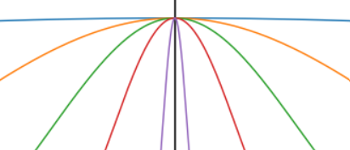
Regression Neural Network
Function Regression
Activation Function
Regression Neural Network
Radial Basis Function
Polynomial Regression
Neural Network

Slide 14
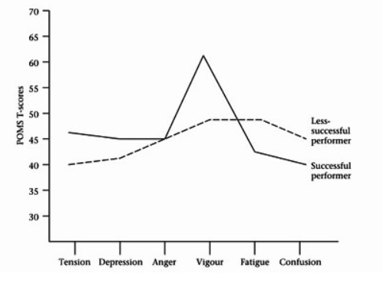
POMS
Questionnaire
Scales
Relationship of POMS and performance
Moods

Slide 15
Autoregressive Model
Time Series Forecast
White Noise
Signal
Nth-order FIR filter
Adaptive Model
Signal at N-steps a head
Parameter Estimation
Least Squares

Slide 16
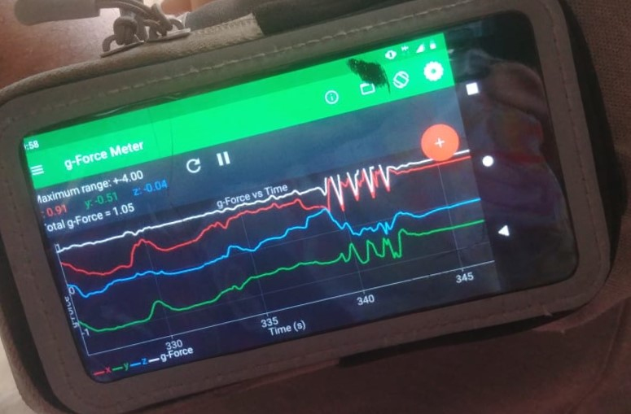


Working of Structure
Utilization of Strategy
Supervised Classifier
Convolution Neural Network
CSV file
WIFI transfer
Function Regression
General Regression Neural Network
Physics Toolbox Accelerometer
Time Series Forecast
Autoregressive model

Slide 17
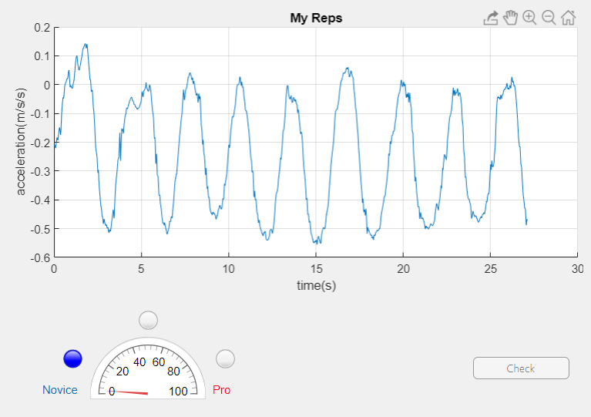
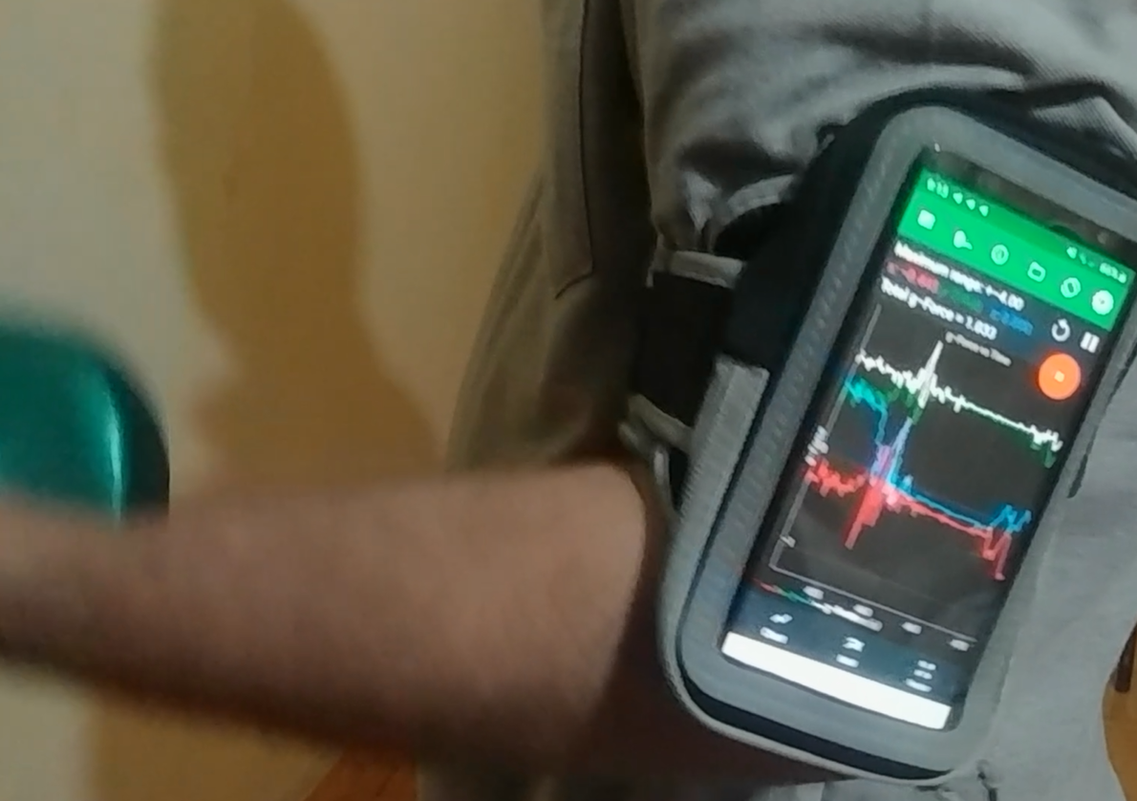
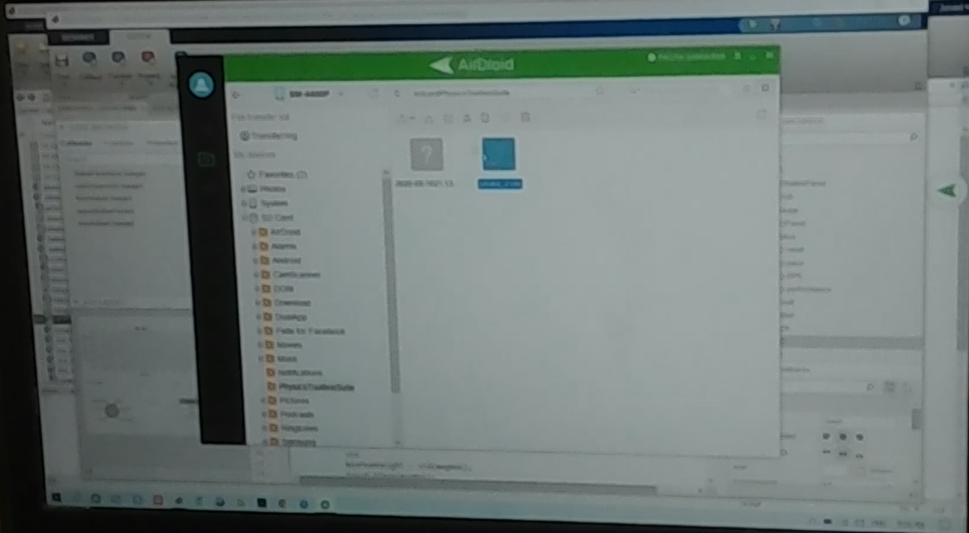

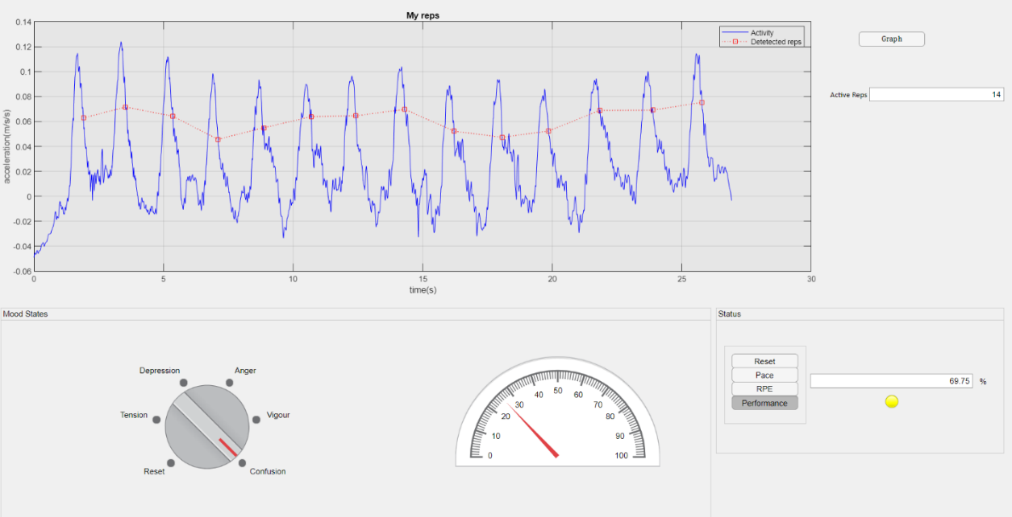
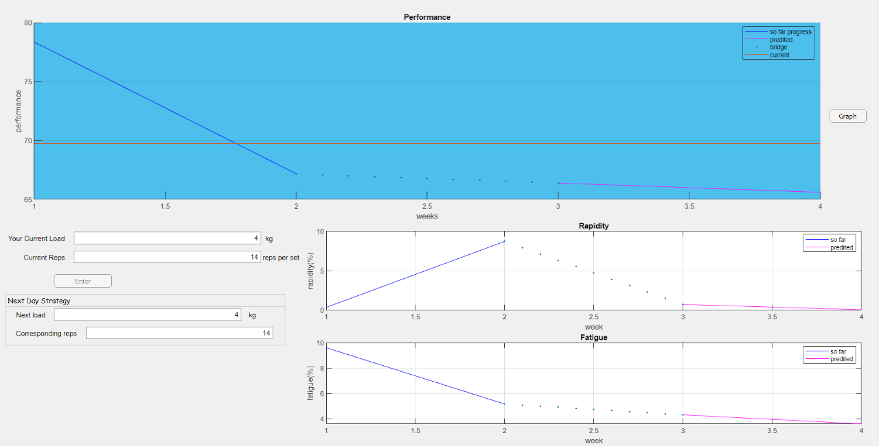
Exactly what is happening
Data automatically transferred to PC through WIFI

Slide 18
Workflow of Monitoring task of project

Slide 19
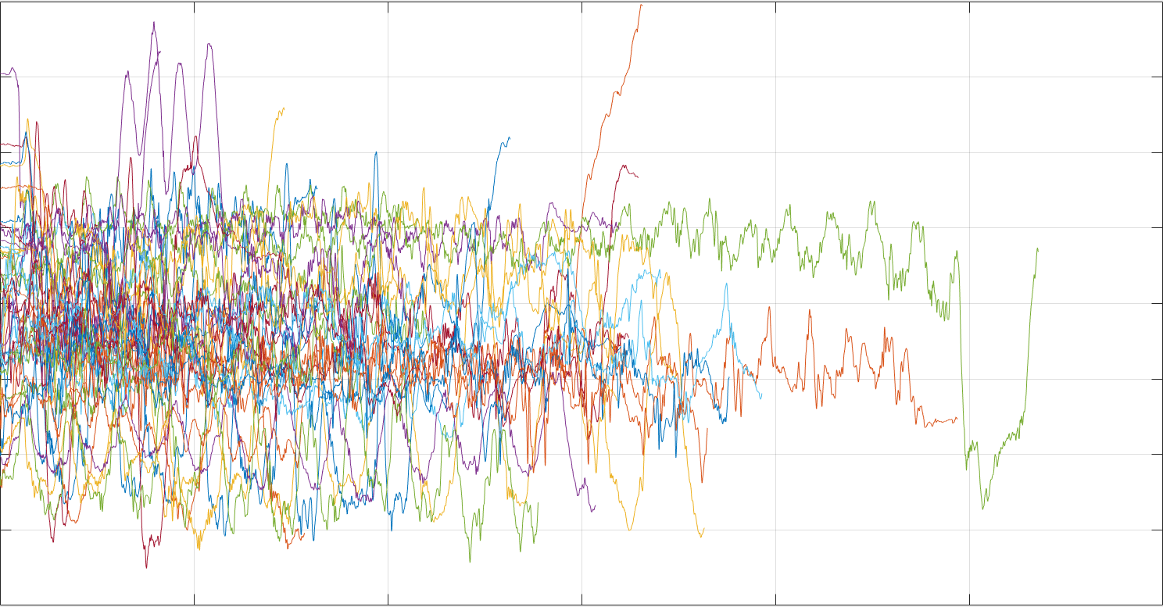
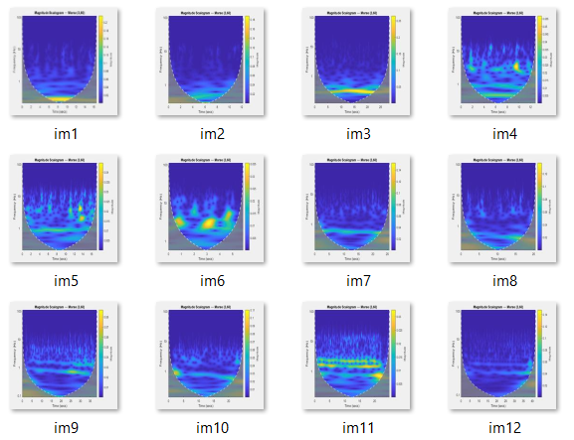

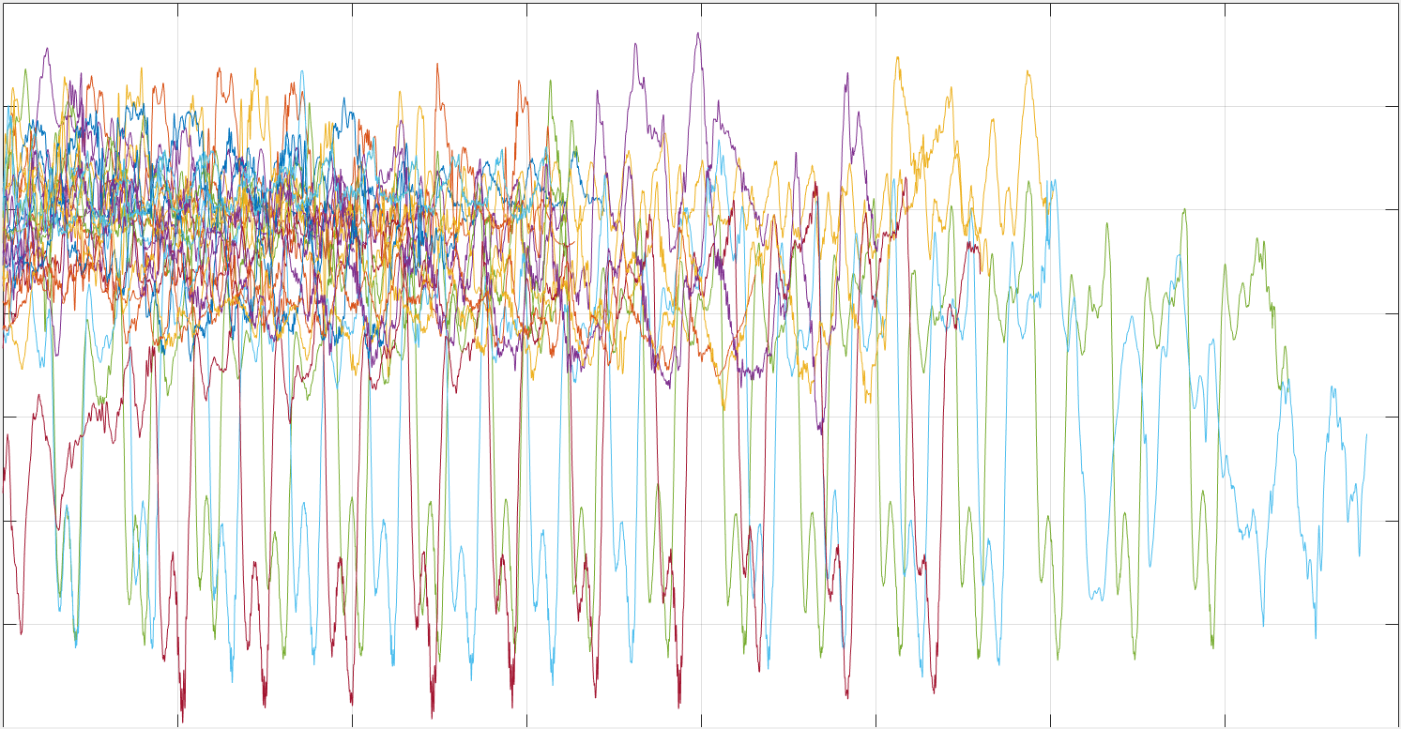
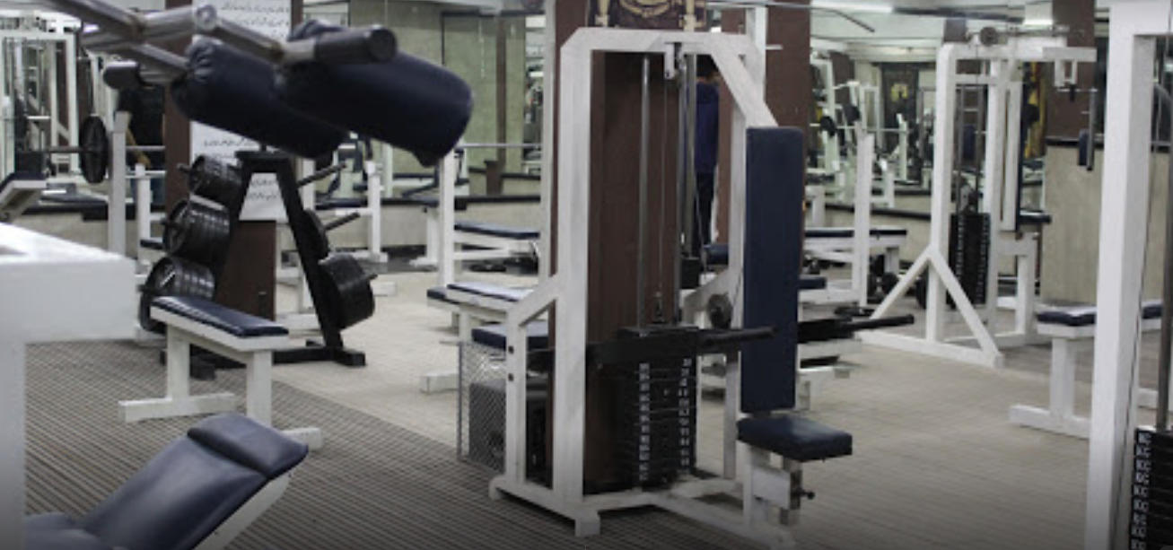
Training of Classifier
Collective Wavelet Scalogram
Accelerometer Dataset
Pace-Rapidity- Fatigue Data
Self-collected from 11 trainees from Hardstone gym
Convolution Neural Network
Novice-professional Data
Hardstone gym

Slide 20
Testing of Classifier
Pace
RPE
Rapidity
Confusion matrix probabilities
Fatigue
Regression Neural Network
Performance
Trained Convolution Neural Network
Novice
Mood States
Pro
Anger
Confusion
Depression
Fatigue
Tension
Vigor

Slide 21
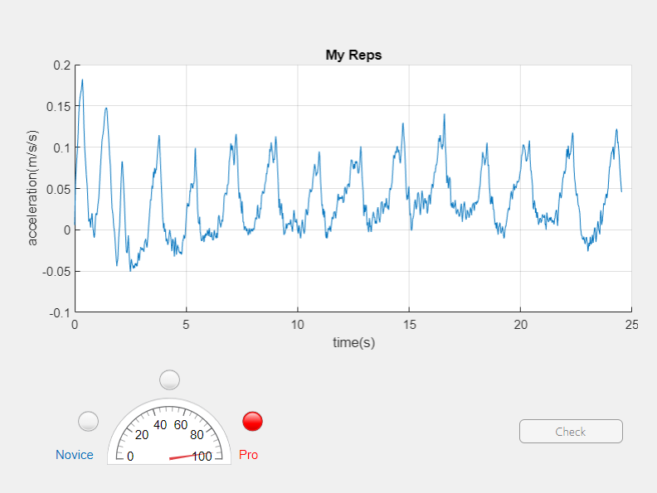
Characterization of accelerometer signal as professional
Characterization of accelerometer signal as novice

Slide 22
Detection of mood states, active reps, Pace, RPE and performance form accelerometer signal

Slide 23
Workflow of Prediction task of project

Slide 24
Rapidity
based on future trends evaluate training strategy
Forecasted
Autoregressive Model
Performance
Fatigue

Slide 25
Next day strategy evaluation form associated forecasted performance, rapidity and fatigue profile

Slide 26
Conclusion
Convolution Neural Network
Automatically transferred through WIFI
Monitoring
Monitoring
Android Phone
MATLAB (PC)
Regression Neural Network
Next Day Strategy Evaluation
Next Day Strategy Evaluation
Records accelerometer data
Autoregressive Model

Slide 27
Extension of the project

Slide 28
LCD Display
Arm Pouch
Bicep Contraction Pressure
Piezo Electric Array
Energy Converter
Rechargeable battery
Voltage Regulator
Embedded System
Accelerometer

Slide 29
Accelerometer
UART
Dataset
Deployed
SVM
C code generated
ATMEGA SAM3X/A
LCD
ARM Cortex-M3

Slide 30
What we get,
Cost
Left Over Benefits
Size
Energy efficient

